Slide 1
Feature Scaling
Przemysław Sekuła

Slide 2
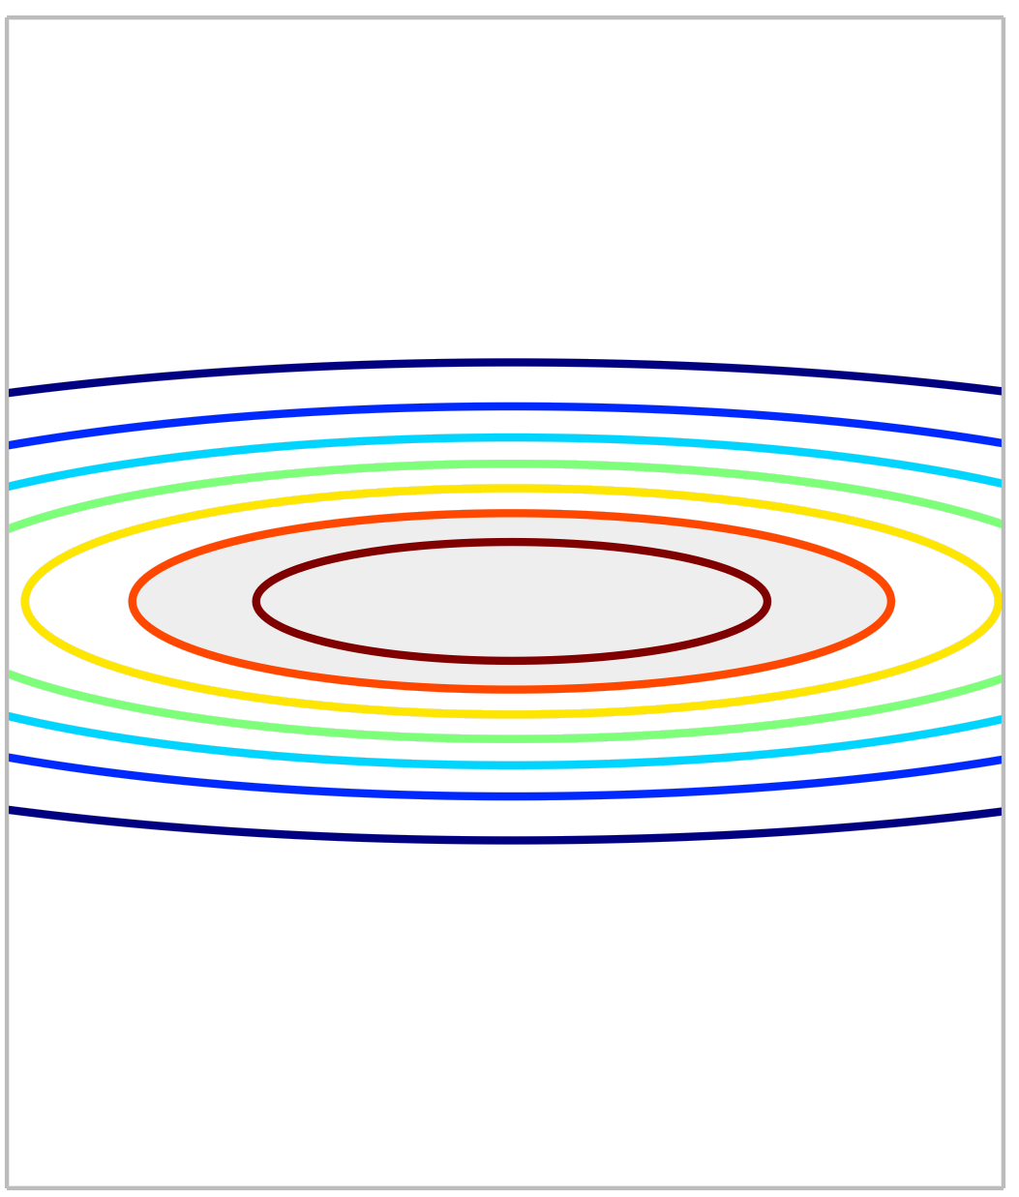
Feature Scaling – problem Description
Assume we have 2 dimensional input
One of the features is in large scale (-1000:1000) and the other in small scale (0:1)
The contour plot of the cost function is probably oval
It may result with very slow convergence

Slide 3
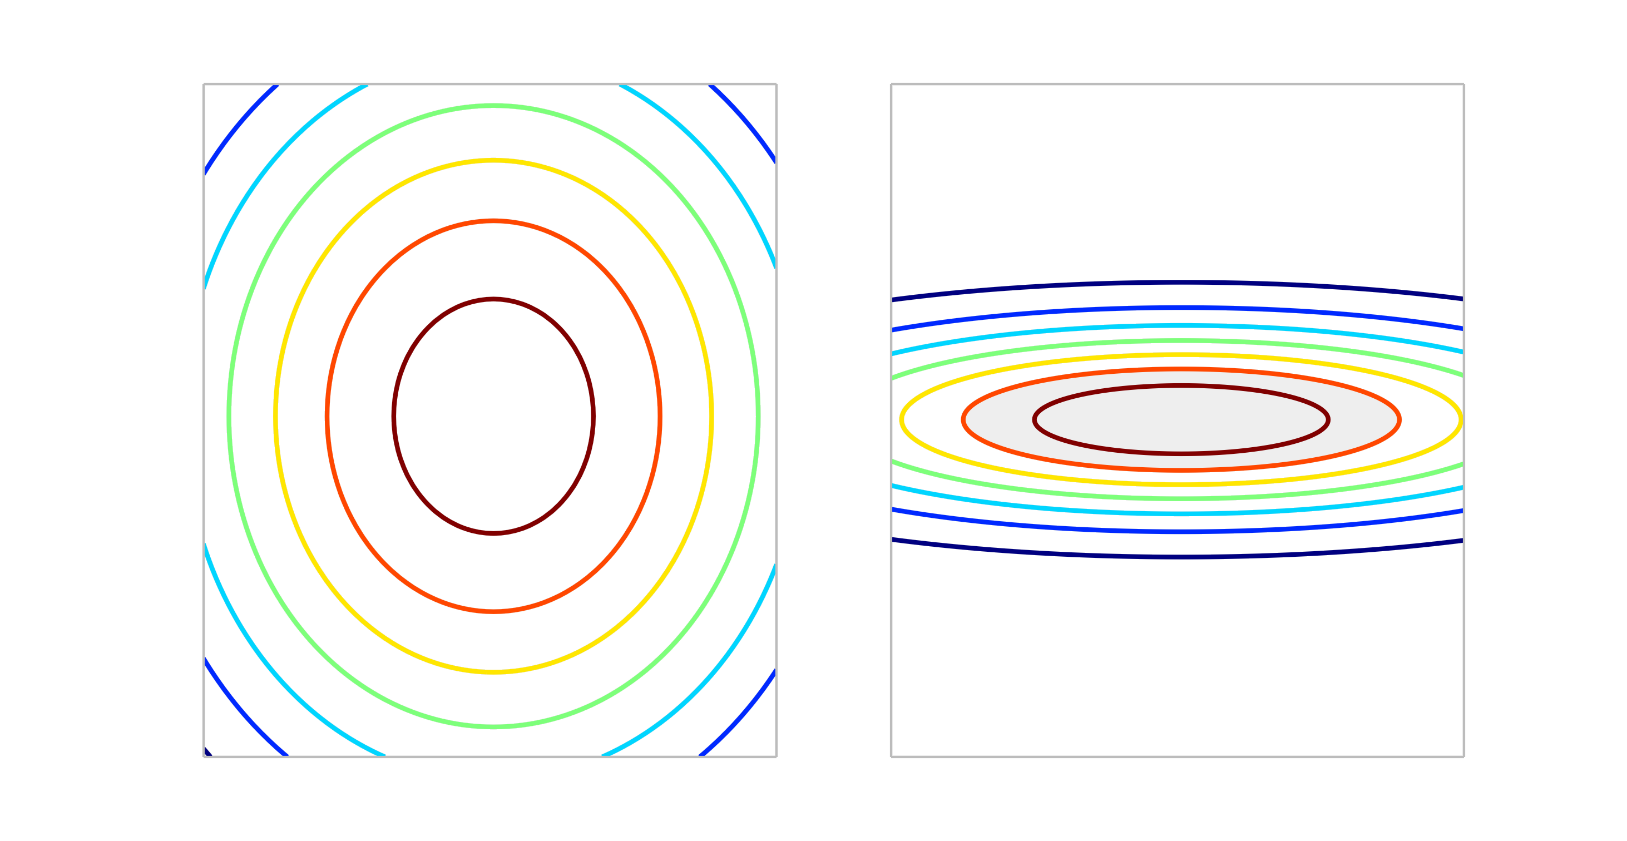
Feature Scaling – Solution INTUITION

Slide 4
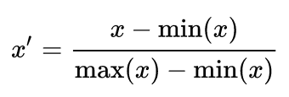


Feature Scaling FOrmulas
Rescaling:
Mean normalization:
Standardization:

Slide 5
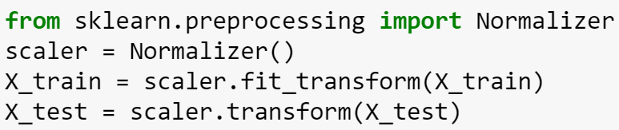
Feature SCALLING in SKLEARN
Rich sklearn.preprocessing library
Normalization example:
Fit_transform = fit and transform (in one line)
Important: You should fit your scaler on training dataset only. Scaler cannot see test datast earlier!

Slide 6
Thank you Q & A

